Slide 1
Jungle presentation 4
The ‘C’ Team:
Jake Marrapode
Ian Franklin
Braiden Wells
Saloni Choudhary

Slide 2
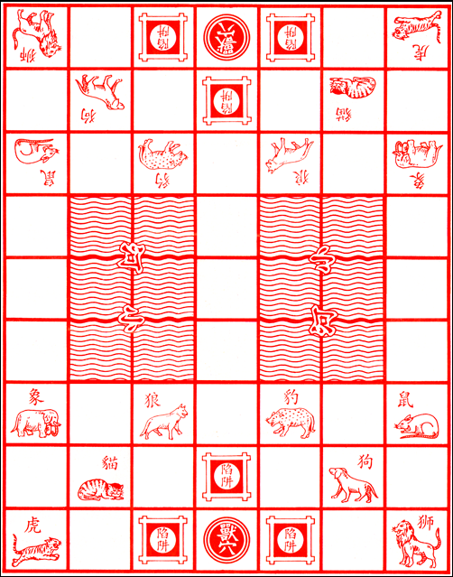
Jungle Game Review
Two players
8 movable pieces per player:
Rat, Cat Wolf, Dog, Leopard, Tiger, Lion, Elephant
Pieces can remove a weaker piece – strength is the listed order
3 Traps per player
Traps remove an opposing player’s piece and are destroyed
1 Den (Objective) per player
Game ends when the den of one player captures another's den
Two rivers that can be crossed only with certain pieces

Slide 3
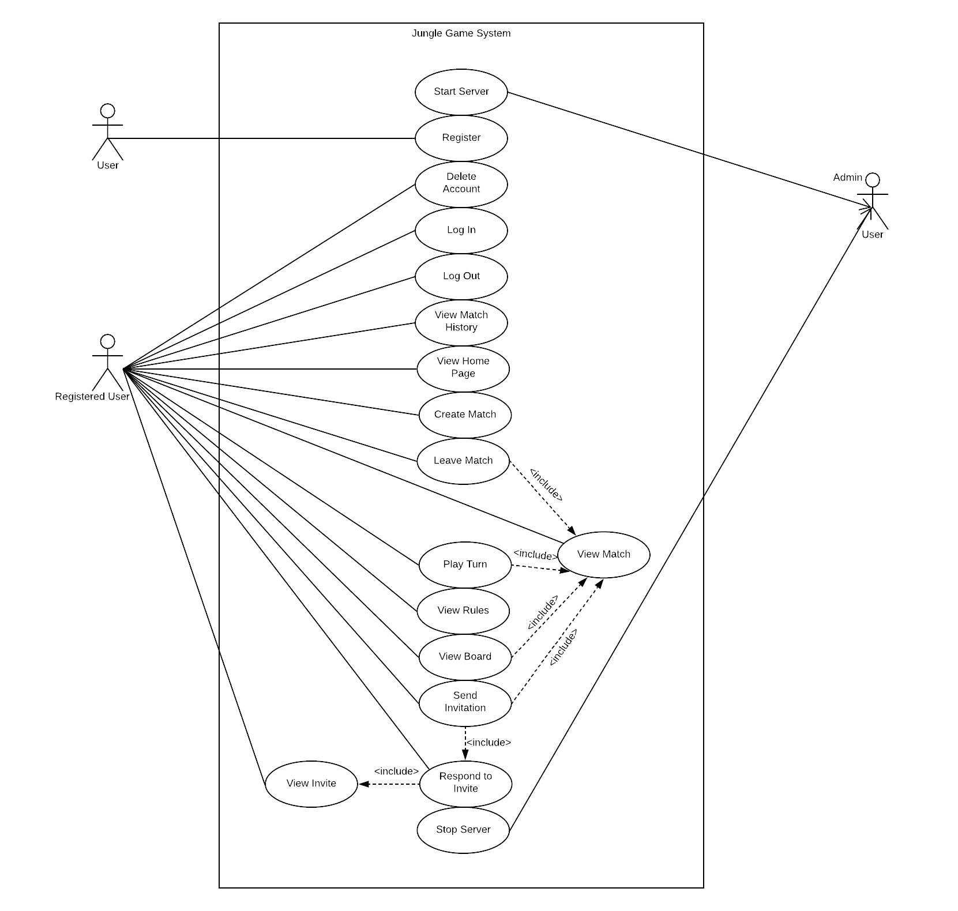
Use Case diagram

Slide 4
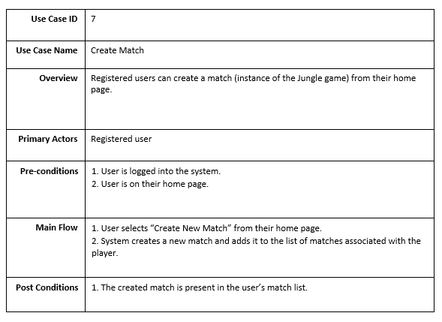
Use Cases

Slide 5
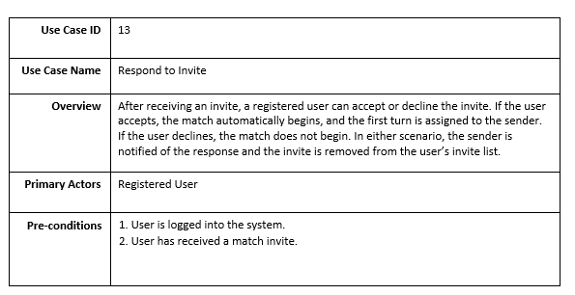

Slide 6
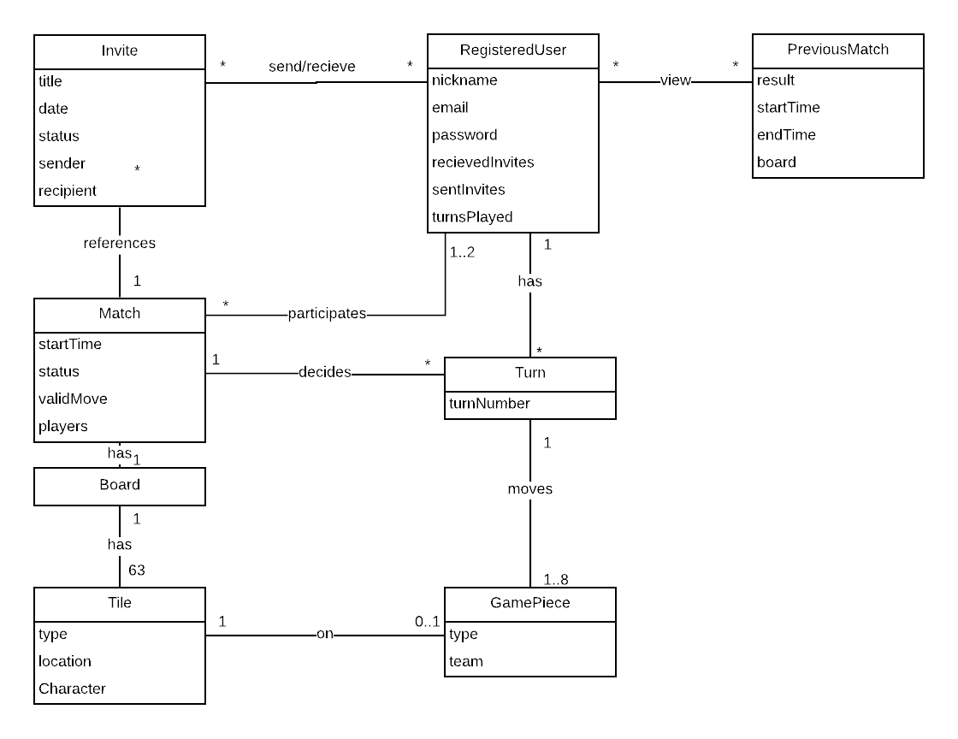
Domain Model

Slide 7
Glossary
Board -A Board represents the Jungle game board for a given match between two registered users. A board has 63 Tiles in a 7x9 grid, which can contain up to 24 Game Pieces in total.
Date- This represents the day an invitation was sent by any user.
decides - This relationship between Turns and Match indicates that the match will ensure which player should play the next turn. A single match decides multiple turns to be played by the players.
GamePiece- A GamePiece represents a Jungle game piece belonging to a user in a given Match. Each user starts a match with 12 pieces, each one a different `type`. In the game of Jungle, there are 8 movable types: _elephant_, _lion_, _tiger_, _leopard_, _dog_, _wolf_, _cat_, _rat_; and 2 non-movable types: _den_, and _trap_.
Invite -An Invite represents the invitations recieved or sent by a particular user for starting a new match between other registered users in the game. A RegisteredUser can send an Invite to another RegisteredUser, which can be accepted or denied.

Slide 8
Class diagram

Slide 9
System sequence diagramS

Slide 10
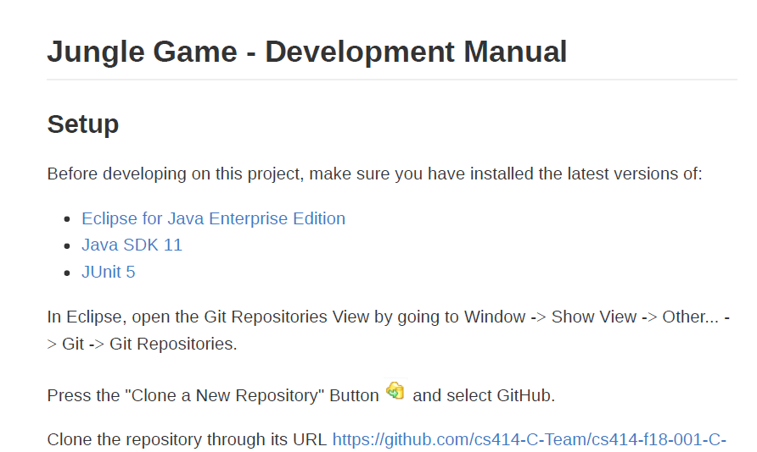
Development manual

Slide 11
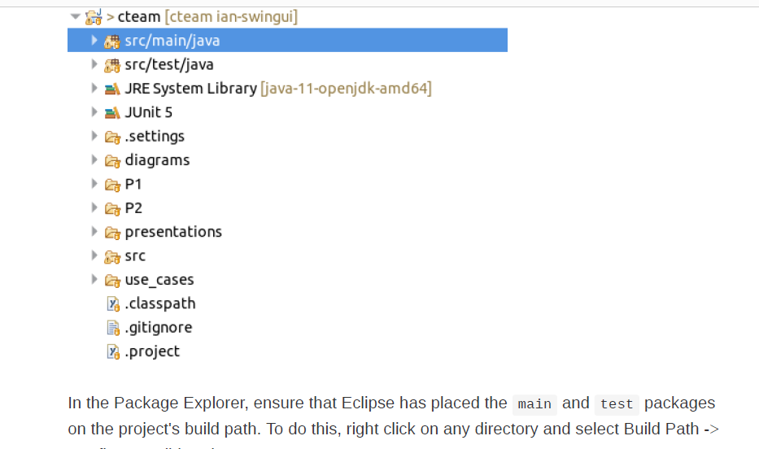

Slide 12
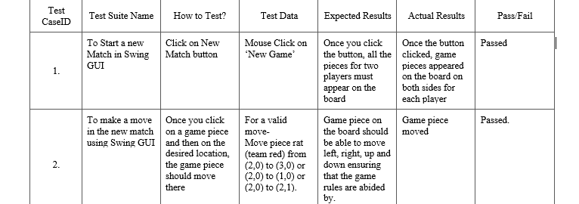
System test cases

Slide 13
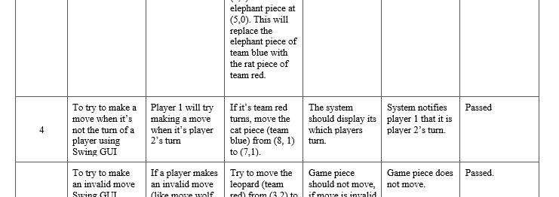
System test cases

Slide 14
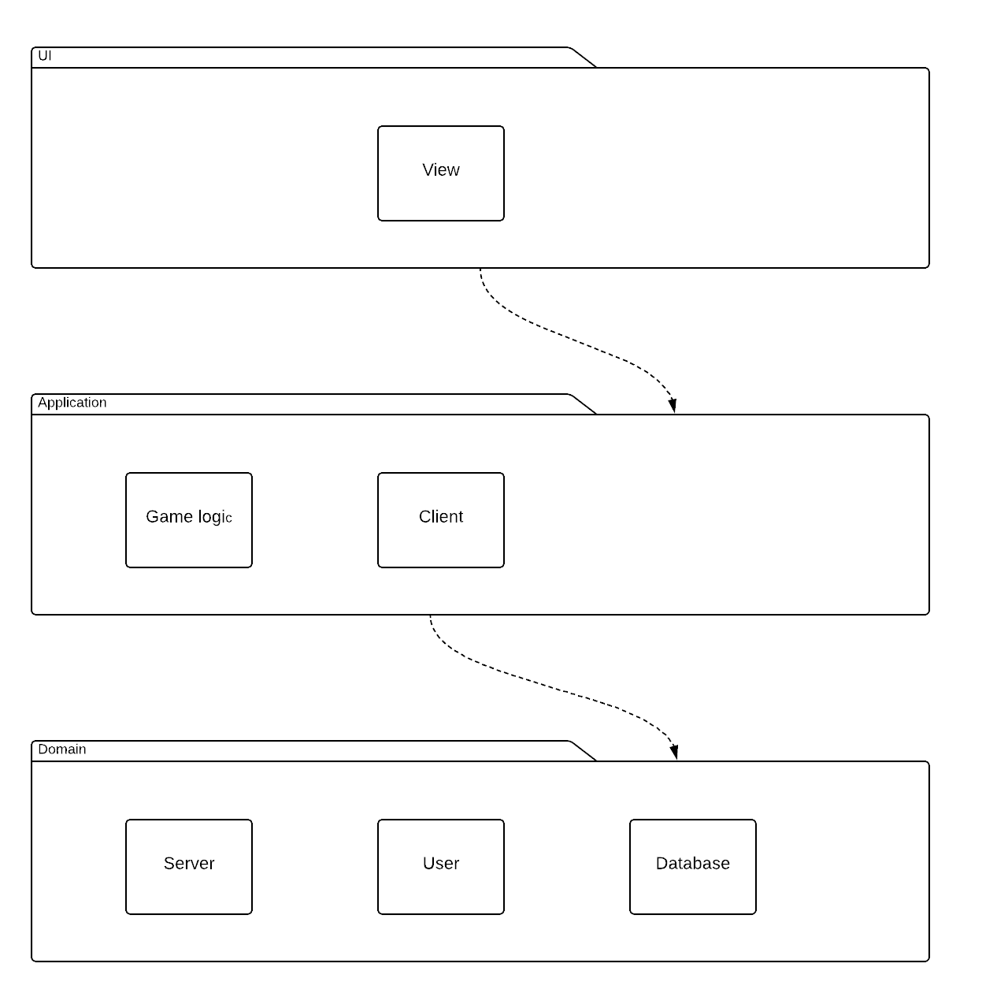
Package Diagram

Slide 15
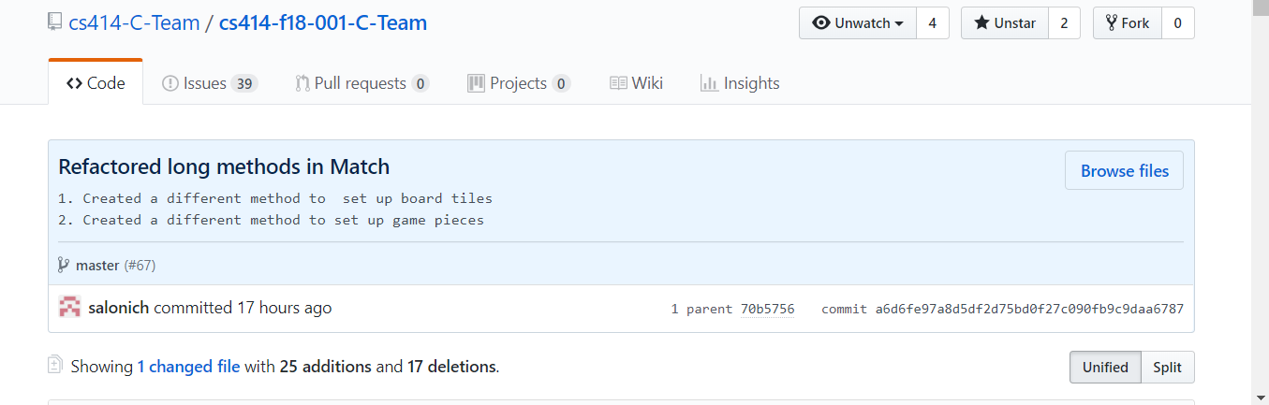
Refactoring

Slide 16
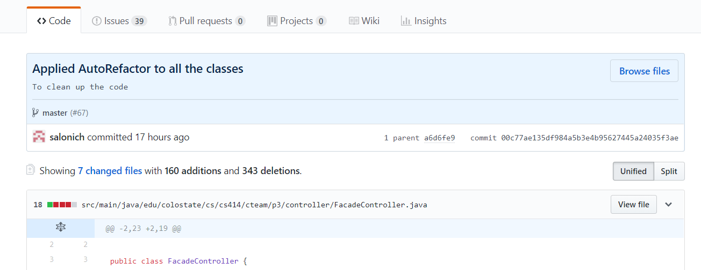
Refactoring

Slide 17
Design patterns implemented
Model View Controller
2. Observer Pattern

Slide 18
Challenges and lesson learnt
Challenges :
Doing the documentation correctly.
Understanding Swing
Setting up the database
Putting together all the components of the system
Try to implement design patterns
Lessons Learnt :
Design Documents are under-rated.
Team work is not that bad.
Using AWS relational database.
Design patterns
Refactoring
Getting Swing under control.
The usefulness of serialization
MVC is very useful for parallel development.

Slide 19
Technologies used
Programming Language – Java
IDE – Eclipse
Github
Zenhub
Refactoring - AutoRefactor

Slide 20
Game Demo

